Slide 1
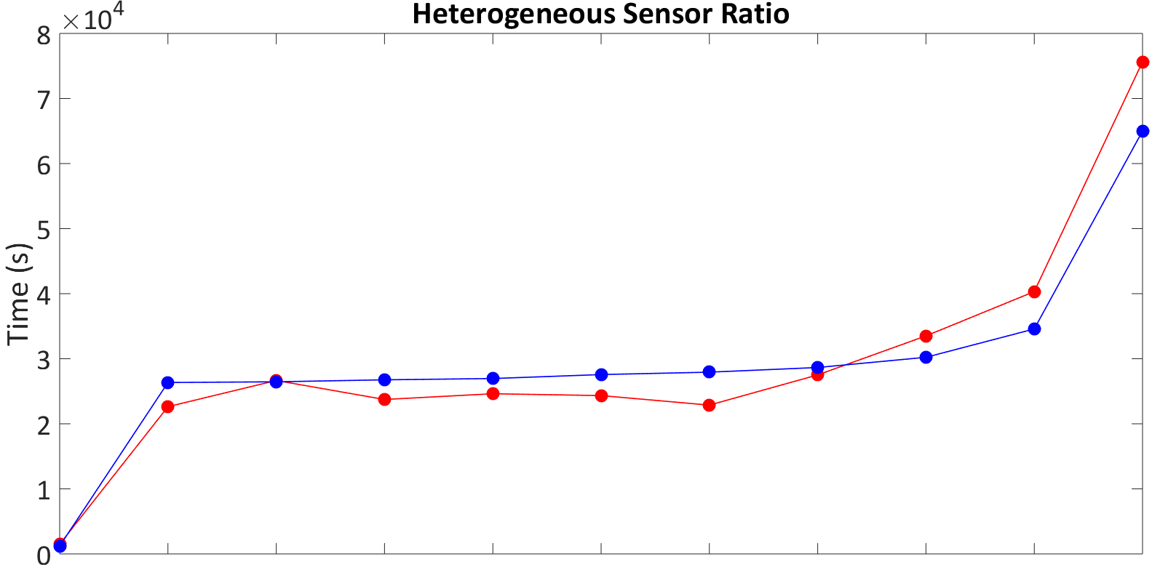
Total Sensors = 5000
Total Sensors = 3000
Smart Darts: 100% 90% 80% 70% 60% 50% 40% 30% 20% 10% 0% Seismic Spider: 0% 10% 20% 30% 40% 50% 60% 70% 80% 90% 100%

